Slide 1
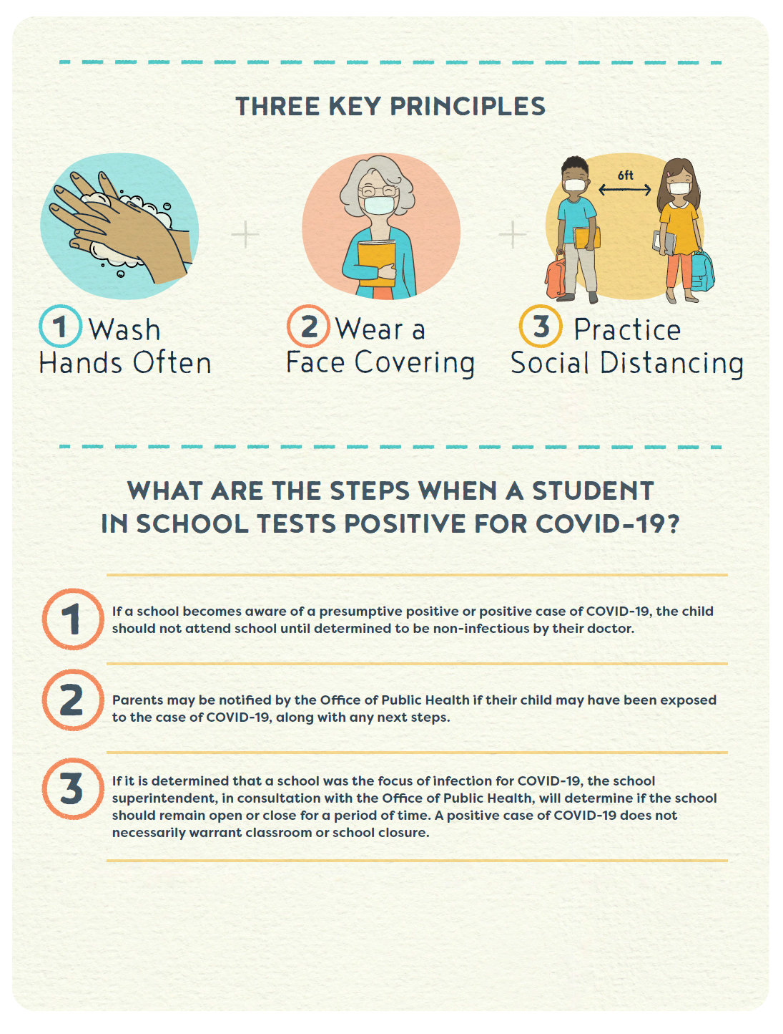

Recommended COVID-19 Response Algorithm for K-12 STUDENTS at School
(rev. 08/04/2020 OPH Region 3)
A local supplement to https://www.louisianabelieves.com/docs/default-source/strong-start-2020/school-reopening-guidelines-and-resources.pdf?sfvrsn=c10e981f_28
Region 3
Assumption, Lafourche, St. Charles, St. James, St. John, St. Mary, Terrebonne
Administrative Headquarters
1434 Tiger Drive, Thibodaux, LA 70301
985.447.0916

Slide 2

Region 3
Pandemic Contacts
For use by schools in Assumption, Lafourche, St. Charles, St. James, St. John, St. Mary, Terrebonne
1. For routine reporting of COVID19 cases where school policy was sufficient and followed use:
R03SchoolLiaison@la.gov
2. For specific school questions about student / staff cases call:
985-438-2552
3. For questions on cleaning and disinfecting contact Sanitarian Services:
Assumption: 985-369-3565; Lafourche: 985 447-0954; St Charles: 985-764-4376; St James: 225-265-4002;
St. John: 985-536-2172; St Mary: 985-385-7018; Terrebonne: 985-857-3770
4. For Superintendents with questions about specific district or school-level policy, contact:
Chip.Riggins@la.gov, OPH Region 3 Medical Director, 985-447-0916 Ext. 332

Slide 3
COVID response Algorithm
The goal of this document is to supplement the LDOE “Strong Start 2020 Reopening Guidelines” to reduce the local transmission of COVID-19.
References:
https://www.louisianabelieves.com/docs/default-source/strong-start-2020/school-reopening-guidelines-and-resources.pdf?sfvrsn=c10e981f_28
https://www.cdc.gov/coronavirus/2019-ncov/community/schools-childcare/schools.html
http://ldh.la.gov/assets/oph/Coronavirus/resources/School-Isolation-Recommendations.pdf

Slide 4
DEFINITIONS
Close contact =
for COVID-19, a close contact is defined as any individual who was within 6 feet of an infected person for at least 15 minutes starting from 2 days before illness onset
(or, for asymptomatic patients, 2 days prior to positive specimen collection)
until the person ends their isolation period (usually 10 days).
Ref:
https://www.cdc.gov/coronavirus/2019-ncov/php/contact-tracing/contact-tracing-plan/contact-tracing.html
http://ldh.la.gov/assets/oph/Coronavirus/resources/School-Isolation-Recommendations.pdf

Slide 5
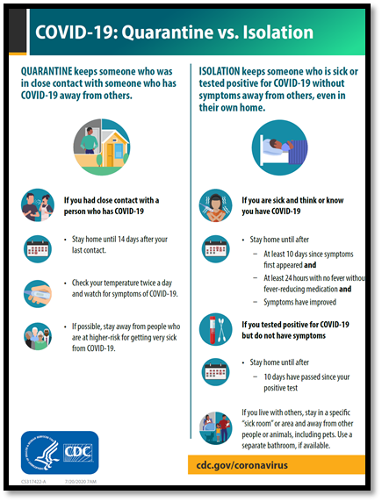
DEFINITIONS
http://ldh.la.gov/assets/oph/Coronavirus/resources/School-Isolation-Recommendations.pdf

Slide 6
Children’s Hospital of New Orleans, LA
LDOE School Health
HOTLINE
(504) 837 – 7760
School-wellness@LCMCHealth.org
Guidance to school nurses and school administrators for medical questions pertaining to a student or team member.
Monday-Friday, 7 a.m. – 11 p.m.
Saturday-Sunday, 8 a.m. – 8 p.m.
CHNOLA-LDOE “Town Hall” Webinar for school nurses/teachers: Tuesday, 8/4/2020, 1-2pm
https://zoom.us/j/99297529593?pwd=VUZWZmo2R0VNS21NWnA0dDZPL3ZzZz09
CHNOLA-LDOE “Town Hall” Webinar for school support staff: Tuesday, 8/18/2020, 1-2pm
https://zoom.us/j/95976608543?pwd=Wm1YR1dkMXA4TW8vY0NWNTVXZDdXQT09

Slide 7
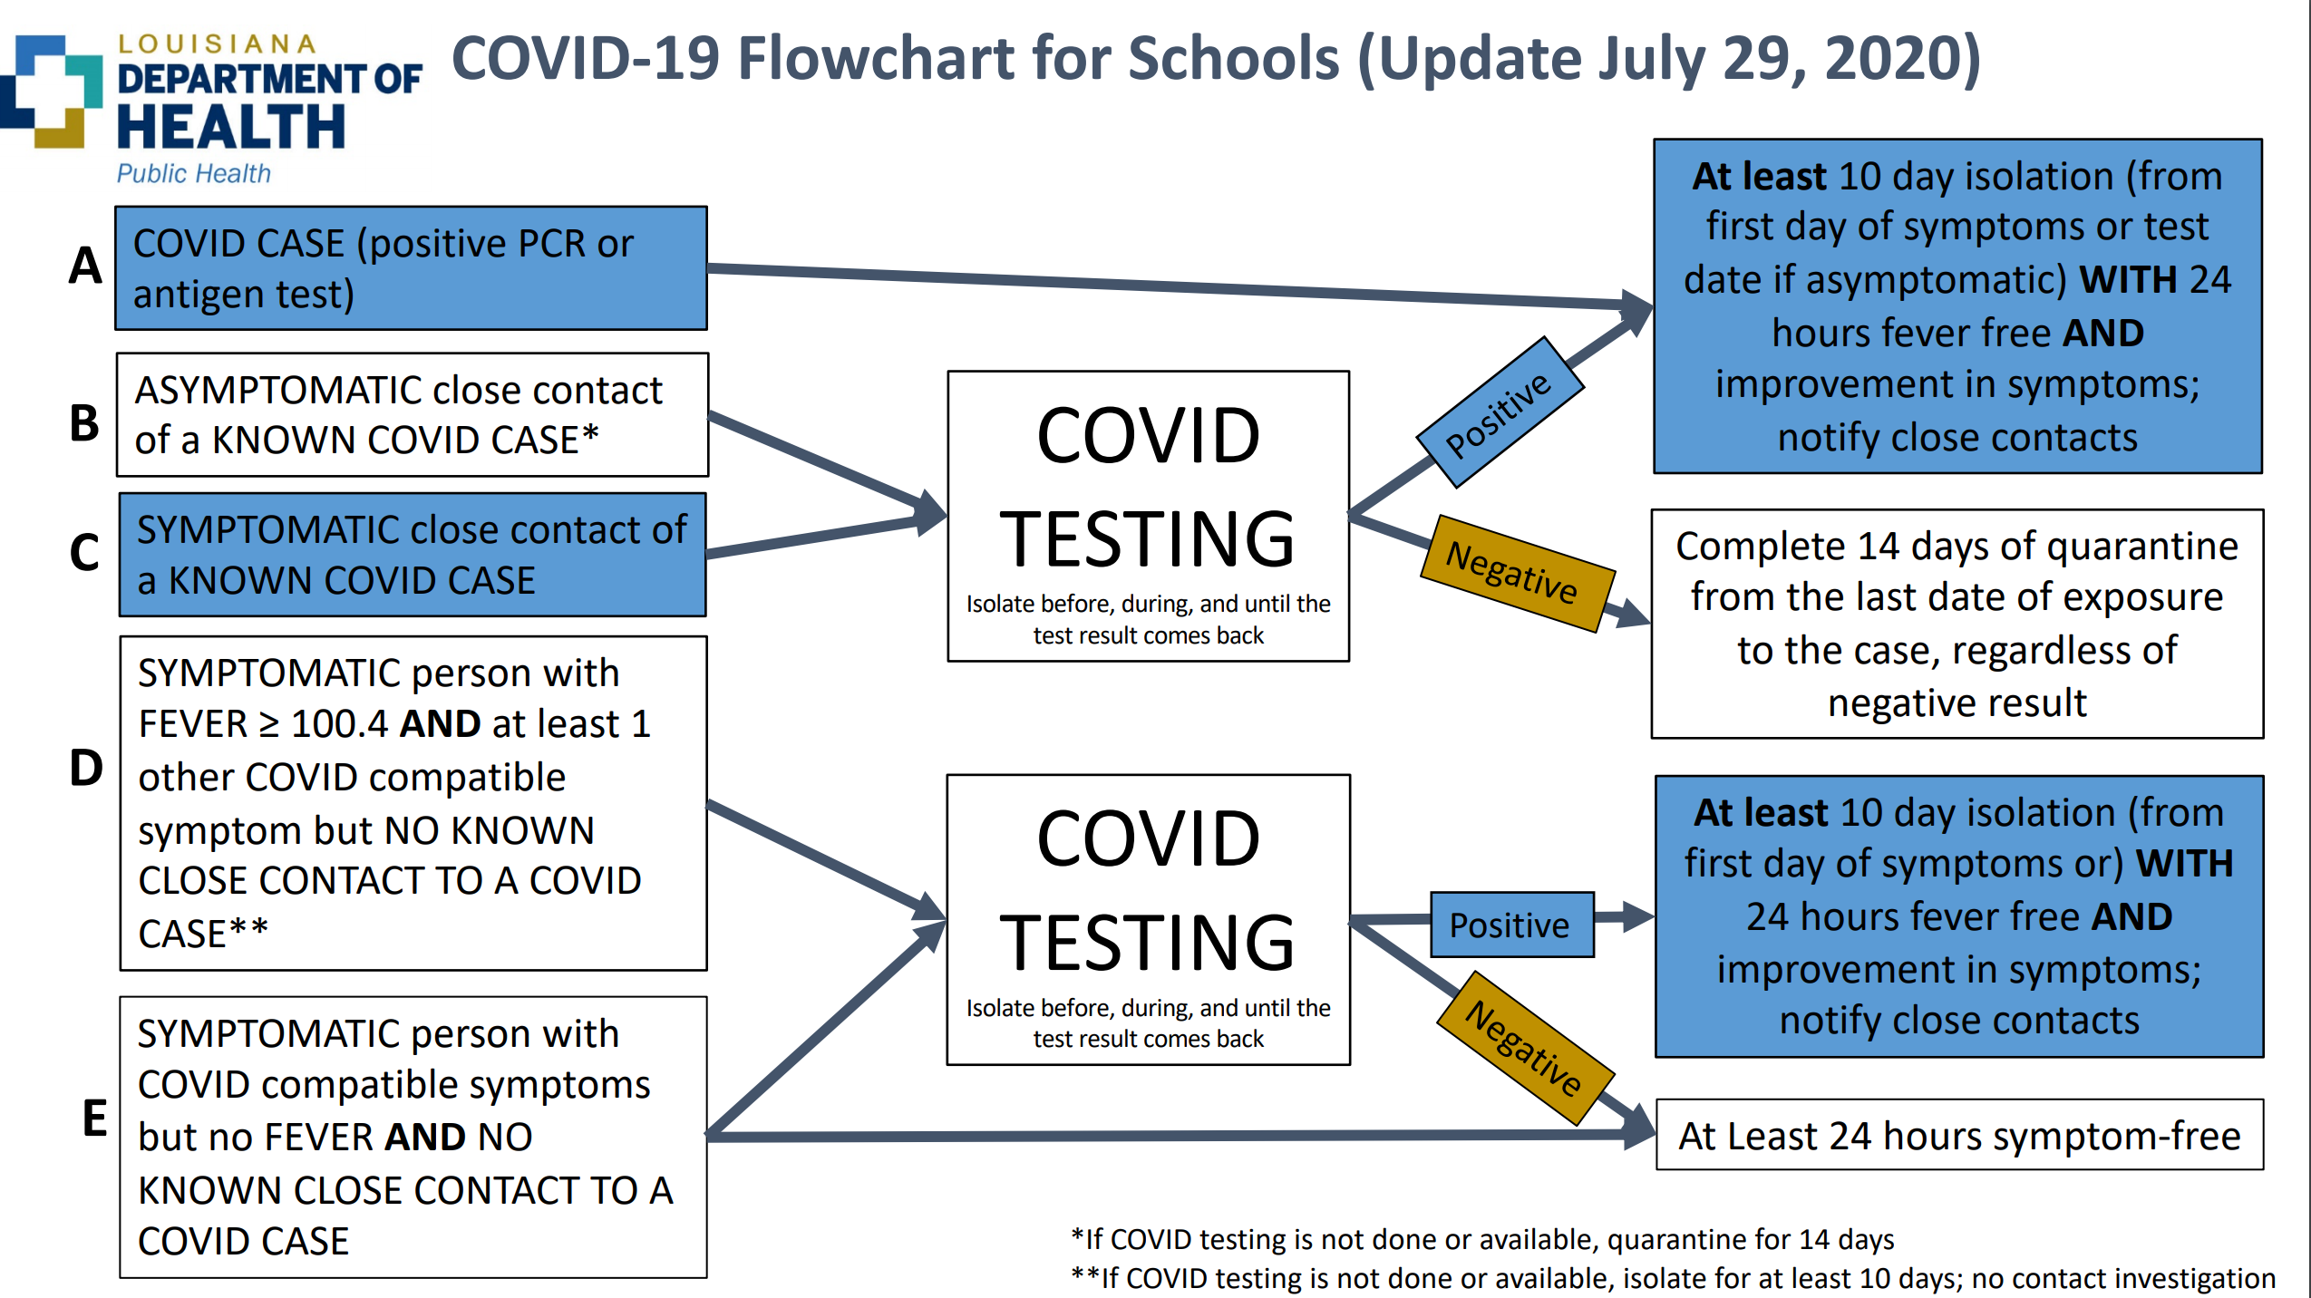

Slide 8
Common STUDENT Scenarios….
LDH-A: COVID Case | LDH-B: Asymptomatic with Close contact of a Known Case | LDH-C: Symptomatic with Close contact of a Known Case | LDH-D: Symptoms, fever But no known contact | LDH-E: Symptoms, no fever, and no known contact
Student has a POSITIVE+ test result for COVID19.* | Student has no symptoms but had close CONTACT to a positive+ case (in or out of school).* | Student has symptoms, and had close CONTACT to a positive+ case (in or out of school).* | Student has a FEVER of 100.4 or greater and other COVID compatible symptoms, but no known close contact.* | Student has COVID compatible symptoms, but no fever, and no known close contact.*
There may be other STUDENT scenarios!
*Refers to standard LDH guidance: http://ldh.la.gov/assets/oph/Coronavirus/resources/School-Isolation-Recommendations.pdf

Slide 9
Student Scenario A:
(Student with Positive Test result)
Student receives a POSITIVE+ test result. *
Student begins 10-days of ISOLATION (from first day of symptoms or test date if asymptomatic).
School notifies CLOSE CONTACTS immediately.
Ex: Health ALERT Letter, CDC attachments, Return Form
School notifies OPH Region 3 by email about positive+ case and total quarantined: R03schoolLiaison@la.gov
Student completes at least 10-day isolation off campus.
Parent/Guardian submits Return-to-School Form
Student resumes school campus attendance with continued strict adherence to physical distancing, hygiene, and masking
*Refers to standard LDH guidance: http://ldh.la.gov/assets/oph/Coronavirus/resources/School-Isolation-Recommendations.pdf

Slide 10
Student Scenario B:
(Asymptomatic Close Contact of Known Case)
Student has CLOSE CONTACT to a positive+ case (in or out of school)
but student is without symptoms. *
If not tested, student begins 14-day SELF-QUARANTINE off campus
from last date of exposure to the positive+ case.
If tested and negative, student still completes 14-day quarantine off campus.
If tested and positive, student begins 10 day Isolation period.
School notifies close contacts (if testing is done and positive).
School notifies OPH Region 3 by email if new positive+ case identified and number of close contacts referred home for self-quarantine: R03schoolLiaison@la.gov
Parent/Guardian submits Return-to-School Form.
Student resumes school campus attendance.
*Refers to standard LDH guidance: http://ldh.la.gov/assets/oph/Coronavirus/resources/School-Isolation-Recommendations.pdf

Slide 11
Student Scenario C:
(Symptomatic Close Contact of Known Case)
Student has CLOSE CONTACT to a positive+ case (in or out of school)
and is symptomatic*
Encourage student to be tested.
If student test is negative, complete 14 days of quarantine.
If student test is positive, complete Isolation period (at least 10 days).
If student does not test, complete Isolation period (at least 10 days).
School notifies close contacts (if testing is done and positive).
School notifies OPH Region 3 by email if new positive+ case identified and number of close contacts referred home for self-quarantine: R03schoolLiaison@la.gov
Parent/Guardian submits Return-to-School Form.
Student resumes school campus attendance.
*Refers to standard LDH guidance: http://ldh.la.gov/assets/oph/Coronavirus/resources/School-Isolation-Recommendations.pdf

Slide 12
Student Scenario D:
Symptoms and Fever but no known contact
Student has a FEVER of 100.4 or greater and other COVID-compatible symptoms. *
If COVID testing not available isolate for at least 10 days
If testing available, encourage student to be tested for COVID-19.
If student is tested and is negative, must remain home until symptom free for 24 hours.
If student is tested and is positive, complete at least 10 day isolation.
School notifies close contacts (if testing is done and positive).
Ex: Health ALERT Letter, CDC attachments, Return Form
School notifies OPH Region 3 by email if new positive+ case identified and number of close contacts referred home for self-quarantine: R03schoolLiaison@la.gov
Parent/Guardian submits Return-to-School Form.
Student resumes school campus attendance.
*Refers to standard LDH guidance: http://ldh.la.gov/assets/oph/Coronavirus/resources/School-Isolation-Recommendations.pdf

Slide 13
Student Scenario E:
(Symptoms, no fever, no known contact)
Student with COVID compatible symptoms but no fever*
Student encouraged to take COVID test.
If testing not done, or if negative test, student must remain at home until at least 24 hours symptom-free
If test positive, complete at least 10 day isolation.
School notifies close contacts (if testing is done and positive).
School notifies OPH Region 3 by email if new positive+ case identified and number of close contacts referred home for self-quarantine: R03schoolLiaison@la.gov
If available, utilize LDOE – Children’s Hospital Hotline: (504) 837–7760
Parent/Guardian submits Return-to-School Form.
Student resumes school campus attendance.
*Refers to standard LDH guidance: http://ldh.la.gov/assets/oph/Coronavirus/resources/School-Isolation-Recommendations.pdf

Slide 14
“For the most accurate results, take a COVID-19 test 5 days* after close contact with a COVID-ill (positive+) person.”
EXAMPLE: Isolation and Self-Quarantine dates scenario
Day 0: Six students have close contact with Joe on Thursday in a class and on the bus.
Day 1: Joe feels sick on Friday and stays home.
Day 2: Joe takes a COVID test Saturday.
Day 4: Joe notifies the school by phone on Monday.
Day 4-13: The 6 contacts get self-quarantine letters Monday, and begin distance learning.
Day 5: The 6 contacts take COVID tests on TUESDAY if testing is possible**.
Day 7: Joe receives confirmation of a POSITIVE test result for COVID19.
Day 10: Two contacts get POSITIVE test results; four contacts get NEGATIVE test results.
Day 12: Joe finishes ten days of self-isolation and returns to class with RTS Form.
Day 14: Fourteen days of self-quarantine ends for the four contacts (Negative result).
Four contacts return to campus if still asymptomatic.
Days 15-24: Two contacts end self-isolation 10 days after tests administered (Positive result). They return to school as long as they are still asymptomatic.
*Johns Hopkins Bloomberg Study, March 2020
**Local test site list: http://ldh.la.gov/index.cfm/page/3934
*** http://ldh.la.gov/assets/oph/Coronavirus/resources/School-Isolation-Recommendations.pdf

Slide 15
LDOE Sample: “Back to School” Letter
Ref: “Strong Start 2020 Guidance” (rev. 7/28/2020)
Parent's “Back-to-school” Decision CHECKLIST:
(CDC 7/23/2020) https://www.cdc.gov/coronavirus/2019-ncov/downloads/community/schools-childcare/back-to-school-decision-checklist.pdf
Childcare Decision TOOL:
https://www.cdc.gov/coronavirus/2019-ncov/community/schools-childcare/decision-tool.html

Slide 16
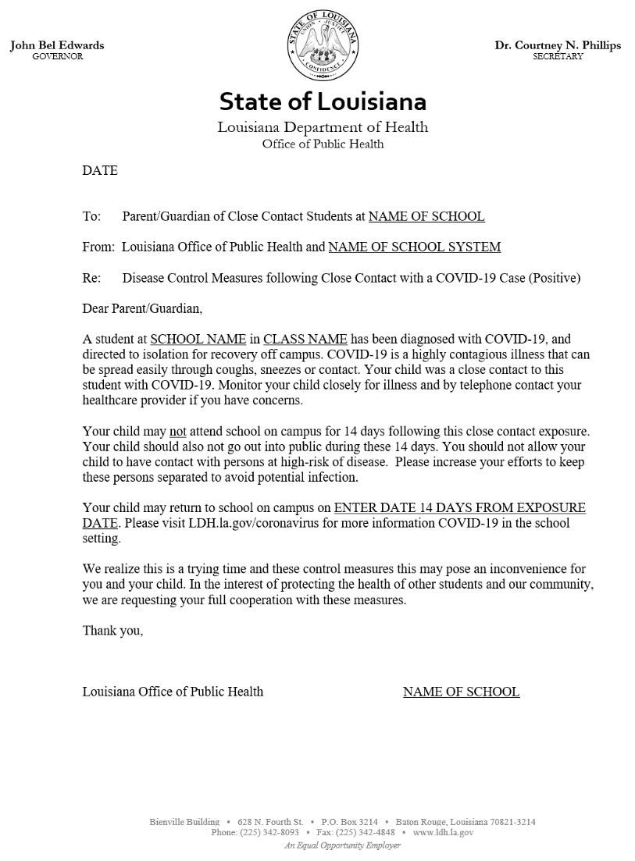
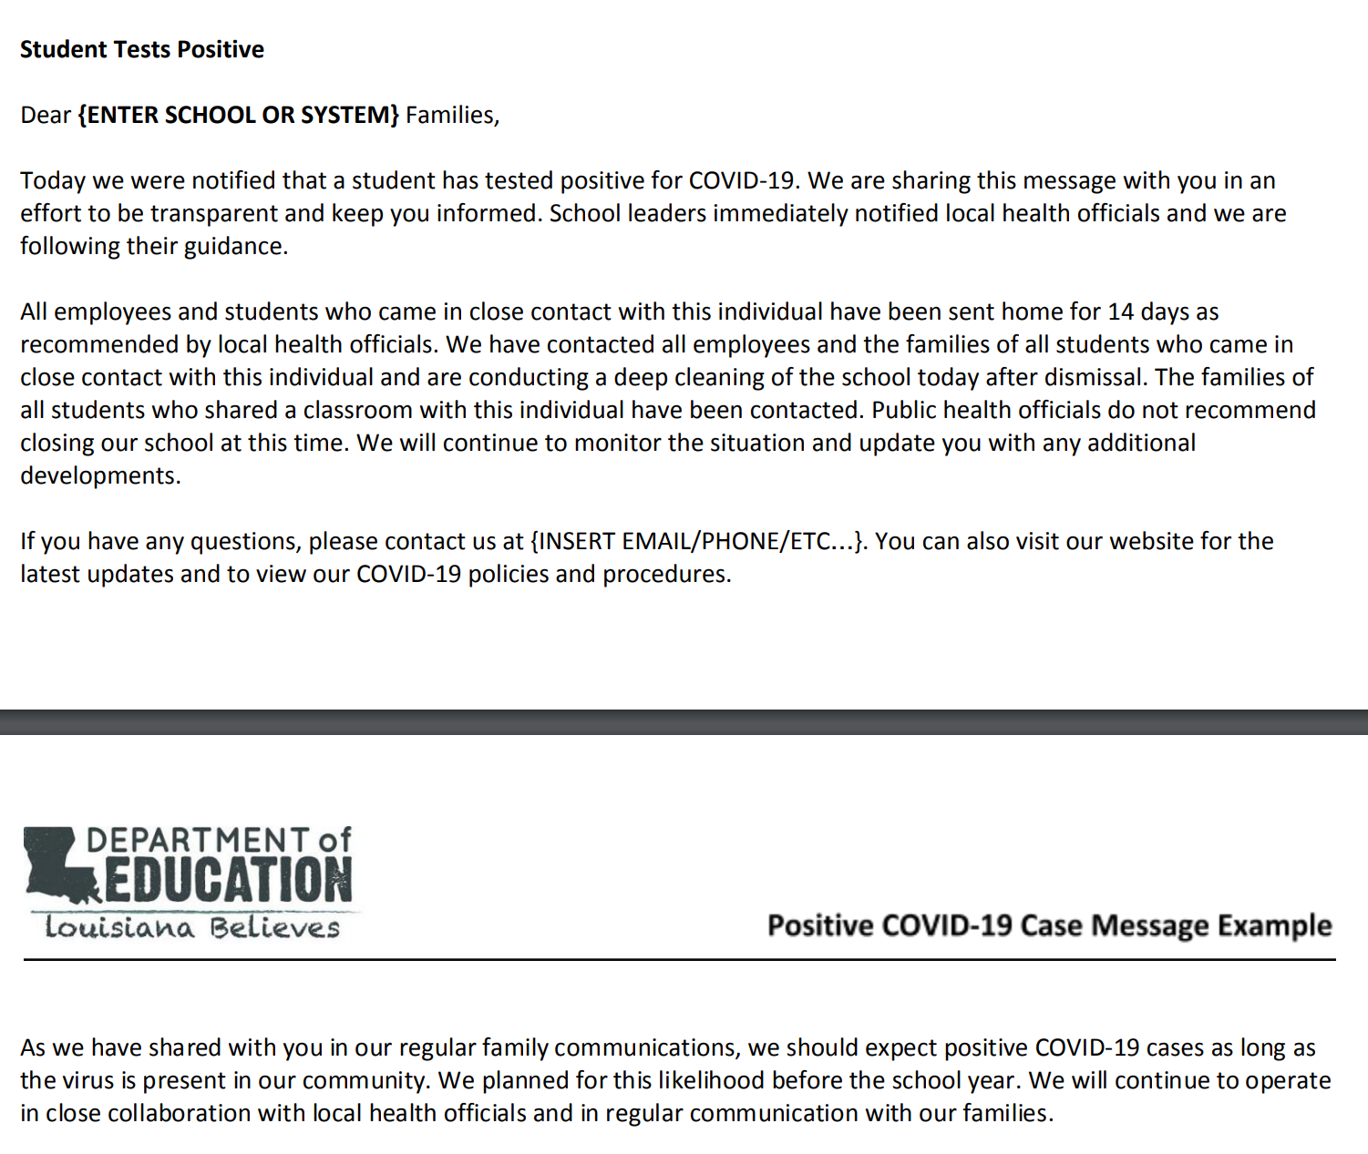
Sample HEALTH ALERT Letter / Email for Students
http://ldh.la.gov/assets/oph/Coronavirus/resources/COVID-19_ReturnToSchoolCertification.pdf
LINK pending (08/04/2020)

Slide 17
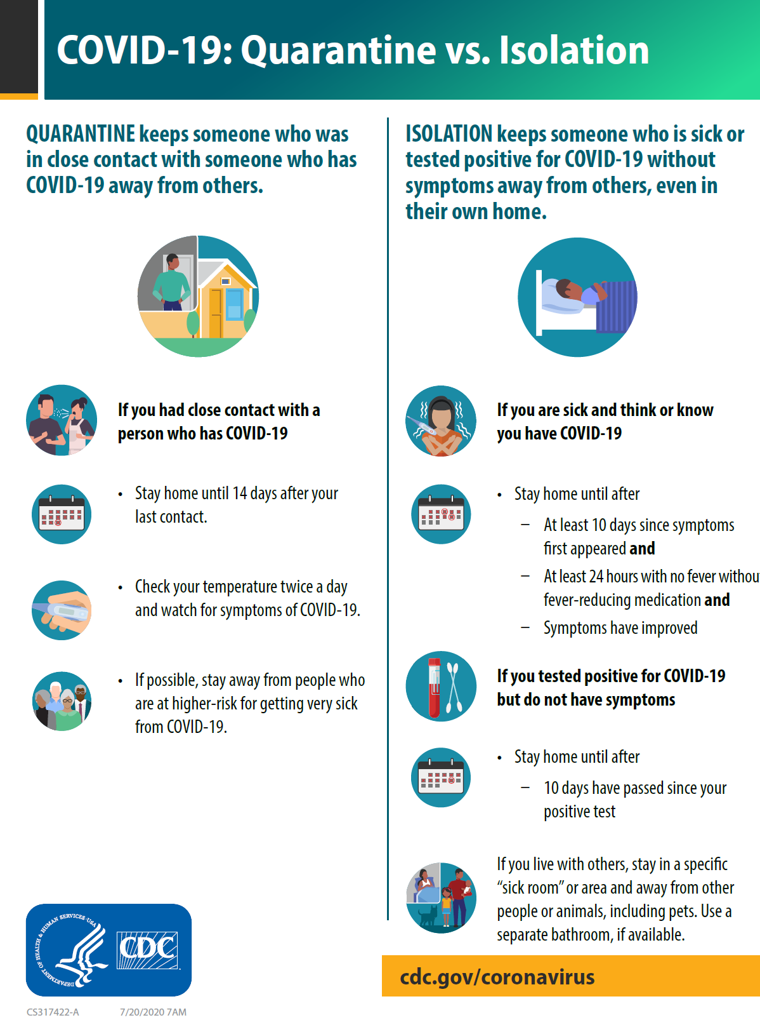
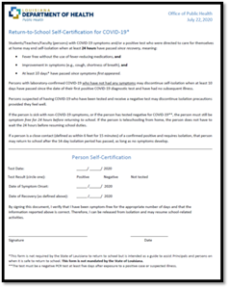
https://www.cdc.gov/coronavirus/2019-ncov/downloads/3key-steps-when-waiting-for-COVID-19-results_508.pdf
Attachments to SAMPLE Letters
https://www.cdc.gov/coronavirus/2019-ncov/downloads/COVID-19-Quarantine-vs-Isolation.pdf
http://ldh.la.gov/assets/oph/Coronavirus/resources/COVID-19_ReturnToSchoolCertification.pdf

Slide 18
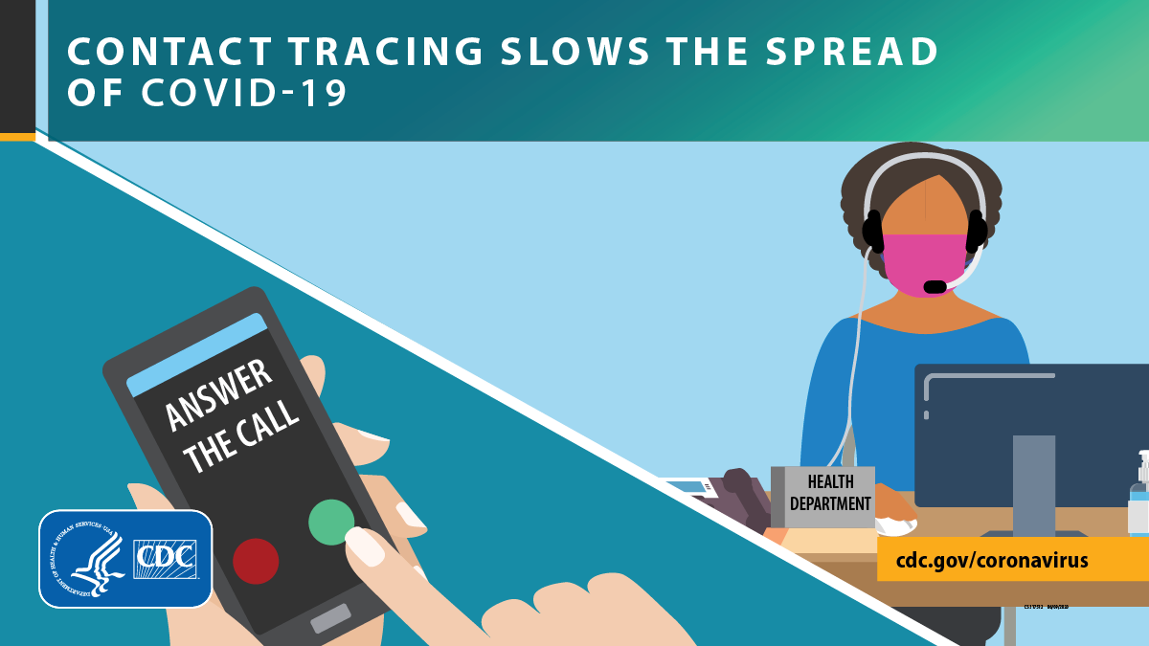

Slide 19
Lagniappe
If you have COVID-19 symptoms,
take a test: http://ldh.la.gov/index.cfm/page/3934
If you receive an 877-766-2130 contact tracer call
from LA Dept. of Health, please cooperate!
Call 211
for general COVID-19 advice, questions and resource information.
Feeling stressed?
Text REACHOUT to 741741 or call 866-310-7977. ☺

